Slide 1

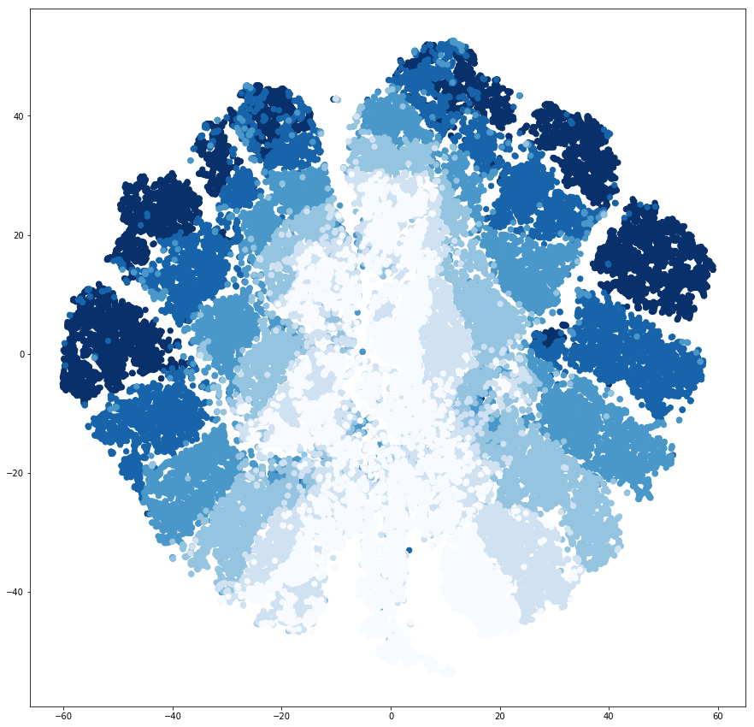
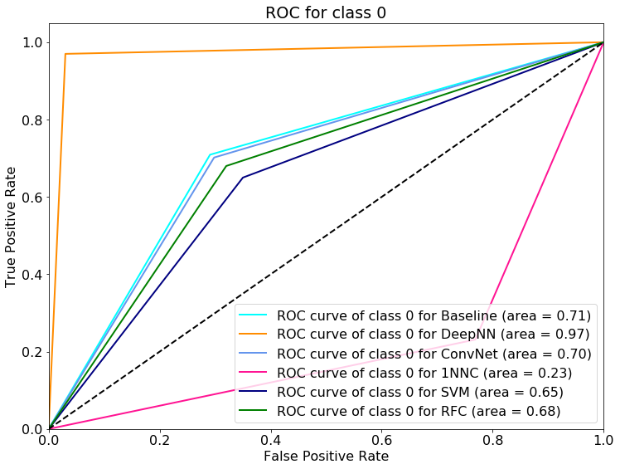
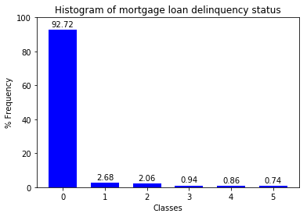
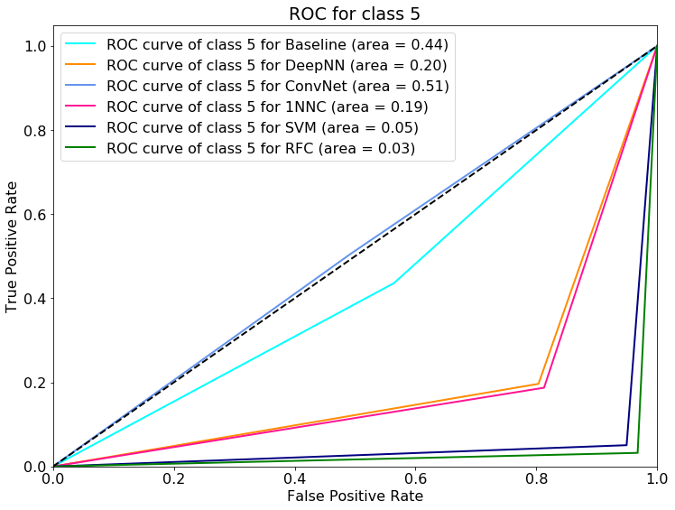

Predicting mortgage loan delinquency status – CS229, Fall 2018
Ksenia Ponomareva, kp260@stanford.edu
Problem Statement
Models
Monitoring of loan performance and early identification of high risk consumers aids prevention of loan defaults and is of interest to many banks and investors. Six multi-classification models have been built that take as input characteristics of a residential mortgage loan at inception as well as information about the first twelve monthly mortgage payments and predict the status of these payments over the next twelve-month period.
Six multi-classification models have been implemented. High-level architecture diagrams for the neural network models are provided in Fig 3-5.
Baseline model has a single node with a softmax activation function.
Deep neural network (DeepNN) model has five hidden layers with 200, 150, 100, 50 and 10 nodes respectively. All activations are ReLU apart from the final one which is softmax. Dropout has been used for each layer to prevent overfitting.
Convolutional neural network (ConvNet) model uses a 1D structure inspired by [3] with two blocks of convolutional and max pooling layers, followed by a fully connected layer and a softmax activation function.
1-nearest neighbor classifier (1NNC) uses known labels in the training data set to calculate the centroids for the six classes and classifies new data into these existing clusters based on the distance from the cluster centroids.
Support Vector Machine (SVM) model performs multi-classification using RBF kernel using one against one approach, where 15 classifiers are constructed and each one trains data from two classes. Class weights, based on the median-frequency in [4], are used to deal with the imbalanced dataset.
Random forest (RFC) model generates many individual decision trees. For each tree, number of variables considered at each split is limited to a random subset. This helps reduce model variance and de-correlate the trees. Best performance has been observed with 500 trees.
Dataset
The dataset used is publicly available Fannie Mae [1] single family loan performance data, providing information about 30 year fixed-rate mortgages issued between 2000 and 2016 and their performance. Each row represents an individual mortgage loan and columns contain 25 variables. Original mortgage rate for each example has been scaled by the average 30 year federal funds rate for the corresponding quarter. This enables comparison of mortgage loans issued over the last 16.5 years.
Only entries with complete information were used and loans that were terminated prior to month 24 were also discarded. Finally, over 5m data entries were split into 90% used for training set, 5% used for dev and test sets each. The class distribution in the data is shown in Fig 1.
Fig 2. T-SNE scatter plot.
Fig 3. ConvNet model architecture.
Fig 4. Baseline model architecture.
Fig 5. DeepNN model architecture.
Features
Dealing with Imbalanced Dataset
The following eight features have been selected: original rate, original amount, original LTV, number of borrowers, debt-to-income ratio, credit score of the borrower, first three digits of the zip code and the mortgage insurance percentage. Values for these features have been normalized. Additionally, loan monthly payment performance information over the first twelve months of the loan terms is utilized.
The ground truth output has six classes with values ranging from zero to five and is based on the actual loan performance (magnitude of delay and frequency of missed monthly payments) over the month 13 to 24.
As seen in Fig 1, approximately 93% of entries belong to class 0. This finding is as expected, since most people would make payments on time in the first two years of their mortgage term. However, this dominance poses some challenges for training.
In this project, balanced mini-batch selection method has been used for training of the Baseline, DeepNN and ConvNet models, as well as a weighted loss function with median-frequency re-weighting, introduced in [4].
Metrics and Results
In order to evaluate and compare performance of the models implemented for this project several metrics are considered. These are recall per class, precision per class, F1 score micro and per class, Gini impurity index and ROC/AUC. Since dataset is highly dominated by class 0, overall accuracy will not provide enough information on how well models predict classes 1-5 and instead can be misleading.
Gini impurity index is only used to compare Baseline, DeepNN and ConvNet performance on the training set, where, due to the balanced mini-batch approach, the true label classes are equally represented and have G=83.33%.
Models have been iterated over various hyperparameters and network architectures to provide the best test accuracy. Sample of results is provided in Tables 1 and 2, ROC/AUC curves for classes 0 and 5 are provided in Fig 6-7.
Data Analysis
T-SNE technique [2] is used to represent each 20-dimensional data point by point on a two-dimensional grid. Ten thousand examples have been randomly selected from each class in the training data set and the resulting t-SNE scatter plot is shown in Fig 2.
Each point has been color-coded depending on its class, with lightest blue corresponding to class 0 and the darker the color the higher the class. It can be observed that there are obvious groupings, although boundaries between clusters are not very clearly defined. It can be deduced that there is a relationship between loan features and class, although at times these are intermingled.
Fig 6. ROC curves and AUC for class 0.
Gini Impurity Index | Baseline | DeepNN | ConvNet | True Label
Training dataset | 81.26% | 81.91% | 82.07% | 83.33%
Table 1 Gini impurity index.
Micro F1 | Baseline | DeepNN | ConvNet | 1NNC
Training dataset | 35.24% | 35.99% | 37.77% | -
Test dataset | 67.69% | 90.82% | 67.22% | 23.11%
Table 2 Micro F1 score.
Conclusions
From the results it can be concluded that there is no clear model winner. Each model has performed well for some of the metrics for some of the classes and not so well for the other metrics for the rest of the classes. The choice of the model will come down to the goals of implementation and the most relevant metric.
Unlike image classification, where all the information is contained in the pixels of the image, the loan delinquency classification problem has a lot of extraneous factors which are not captured in the loan application details and performance. The models implemented here can be further enhanced by considering more than the first twelve payments as features or supplementing with current/savings/credit account data as in [3] or with macro economic factors, which might help improve models’ performance.
Fig 1. Frequency distribution of each class in the dataset.
Fig 7. ROC curves and AUC for class 5.
References
https://loanperformancedata.fanniemae.com/lppub/index.html
Hinton, G., (2008) Visualizing data using t-SNE, Journal of Machine Learning Research, 9, 2579-2605.
Kvamme, H. Sellereite, N., Aas, K., Sjursen, S. (2018) Predicting mortgage default using convolutional neural networks, Elsevier Expert Systems with Applications, 102, 207-217.
Yeh, I., Lien, C., (2009) The comparison of data mining techniques for the predictive accuracy of probability of default of credit card clients, Elsevier Expert Systems with Applications, 36, 2473-2480.
Poster video link:

